Slide 1

INSIGHTS AND SOLUTIONS TO IMPROVE IT SERVICE DELIVERY TO FEDERAL DEPARTMENTS
Team:
Nitish Kumar Pilla ( Master’s Student in CS at bishop’s University )
Wesley Howe ( Bachelor’s Student in CS at University of Ottawa )
Doan vo ( Master’s Student in CS at bishop’s University )
Phuoc Lien ( Master’s Student in CS at bishop’s University )
GitHub

Slide 2
OBJECTIVE
Our Objective is to improve the IT Service Delivery by Shared Services Canada. Below are some of the problems we selected to get Insights and find ways to improve the service.
Identify tickets that are bounced between support groups or remain open for long periods of time to inform process improvements and find insights on that data.
Find a correlation between the number of times an incident is reassigned and how long it took to restore.
Which support teams need to be engaged to improve service delivery?
Defining the time between when an incident occurs and when SSC actively starts working on an incident would be another indicator to help SSC improve our processes.
Solutions to improve MTRS (Mean Time to Restore Service)

Slide 3
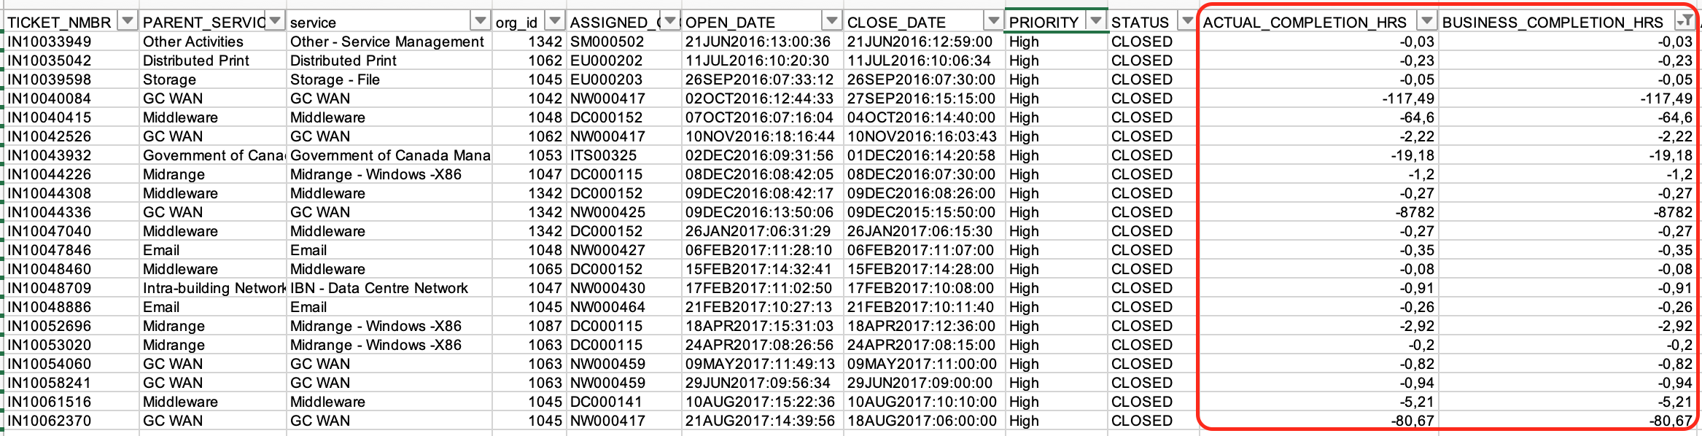
Data Preparation
The given data has incorrect completion hours due to the close date occurring before the open date. This led to negative calculations values for the actual hours and business hours.
In order to resolve this and to get business hours at each status change, we wrote a script which calculates the actual hours and business hours by taking the open dates and close dates of the tickets. Our scripts are created by keeping the priority of the ticket and status of the ticket in mind for accurate results.
Basic cleaning is done, ie: removing invalid characters and null values.
Null values are removed based on the Problem we are dealing to avoid data loss for Analysis

Slide 4
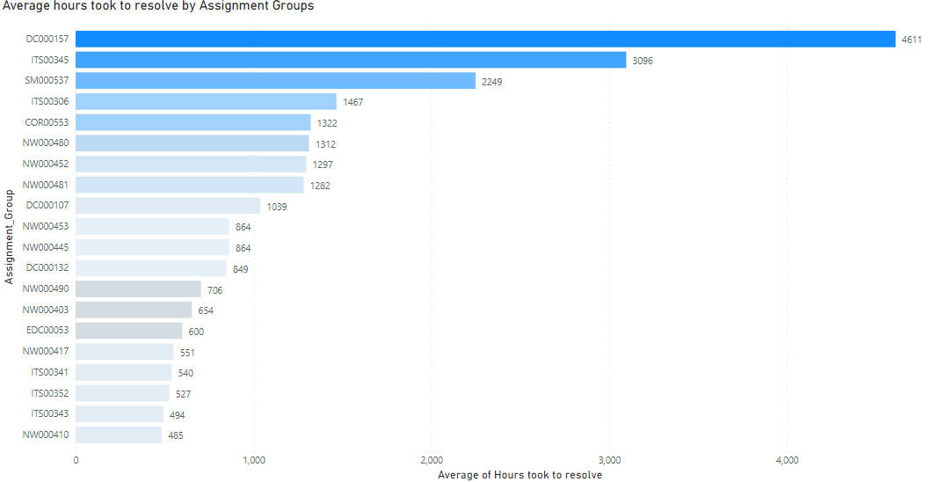
Data Insights and Findings (1)
The given data has incorrect Actual hours and Business hours and for some of the tickets the Close date occurred before than Open date of This let to negative calculations in the Actual hours and Business hours . We also dealt with null values according to the problem we are dealing with
We found that there are some assignment groups that are taking a long time to resolve tickets, resulting in a high MTRS.
If 10% efficiency is increased on these Top 10 assignment Group which take long time to resolve, there is 7.11 % increase in efficiency of MTRS. The Top 20 Assignment Groups and their average hours taken to resolve an issue is below.

Slide 5
Process Improvement:
Set the action plan for Improving team effectiveness for those assignment Groups.
Clarifying goals, roles, and responsibilities to improve the performance of the groups

Slide 6
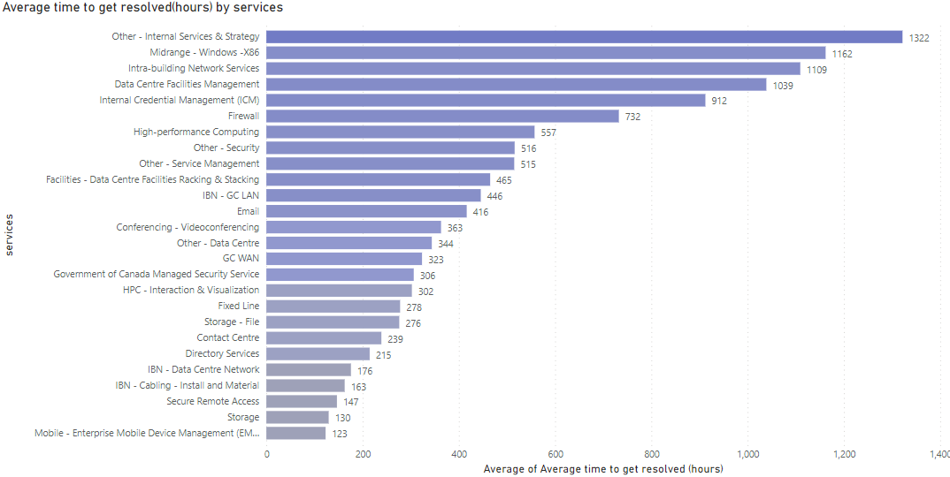
Data Insights and Findings (2)
By looking at the lengthiest tickets, we found that some of the services take longer than average to be resolved. Below are the services and their MTRS.
If the top 10 services became 10% more efficient, there would be a 7% overall decrease in MTRS for SSC.

Slide 7

Suggestions for Process Improvement:
Consider the Top 10 services that are taking long time resolve and analyze the ticket description and reason behind long time.

Slide 8
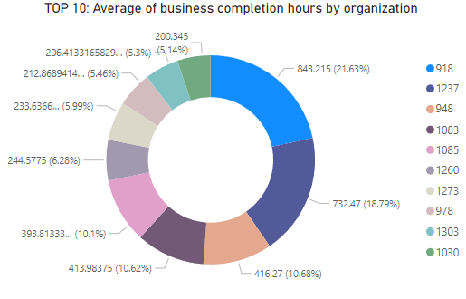
Data Insights and Findings (3)
We found that some of the organizations have higher MTRS. Below are the 10 organizations that whose tickets take the longest to get resolved.
If these organizations had a 10% lower MTRS, there would be a 2.7% overall decrease in MTRS for SSC.

Slide 9
Process Improvement:
Finding services that are linked to these organizations and improving them will have a positive impact on decreasing the MTRS.
Deep analysis on ticket descriptions could be used to find other solutions.

Slide 10
Data Insights and Findings (4)
We did find a weak correlation of 0.305 between the number of times an incident is reassigned and how long it took to restore.
We used 3 correlation methods (Kendall, Spearman, and Pearson). The Spearman correlation is 0.305.

Slide 11
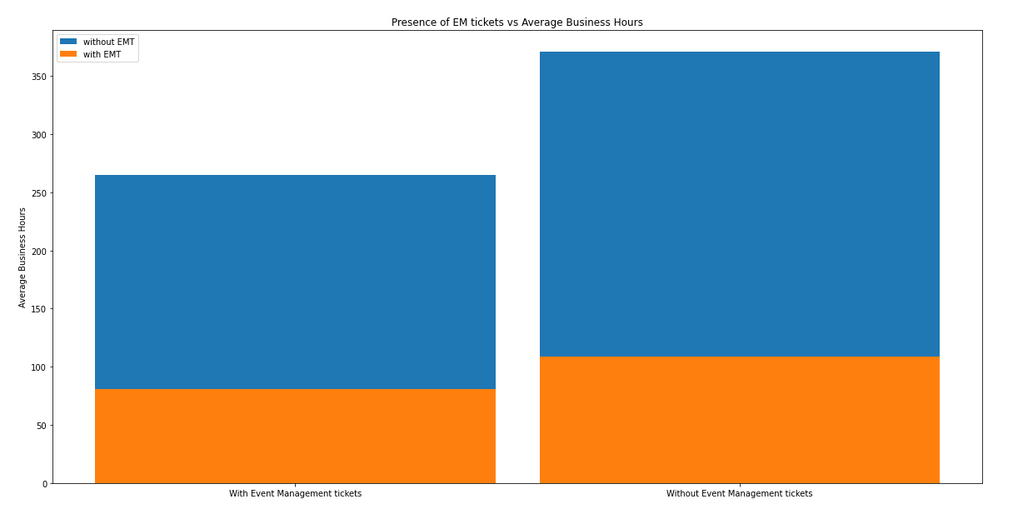
Data Insights and Findings (5)
We found that there is 40% Increase in Actual Time Completion and 34% Increase in Business time without Event Management Tickets. Below is the table that shows numbers related to event management tickets.

Slide 12
Data Insights and Findings (6)
We found the average time between when an incident occurs and when SSC starts working on it, by priority.
For low and medium priority incidents the average time taken by SSC to respond is around 20 hours.
For high priority tickets, SSC takes an average time of 52.8 hours to respond. This is largely due to certain tickets that take a very long time to resolve, and which are frequently reassigned.
Priority | Average Hours took to for SSC to Act
Low | 20
Medium | 20
High | 52.8
From the above table we can see that the response time is higher for high priority incidents. As the high priority tickets undergo more escalations, the amount time it stays in Queued status increases.
In order to decrease the time that SSC take to respond to a newly opened ticket, the resources to handle the tickets should increase.

Slide 13
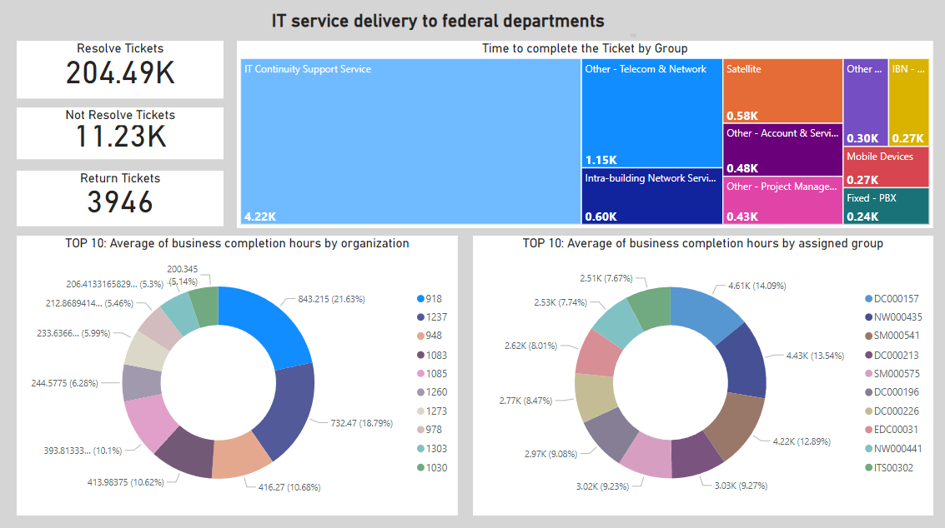

Slide 14
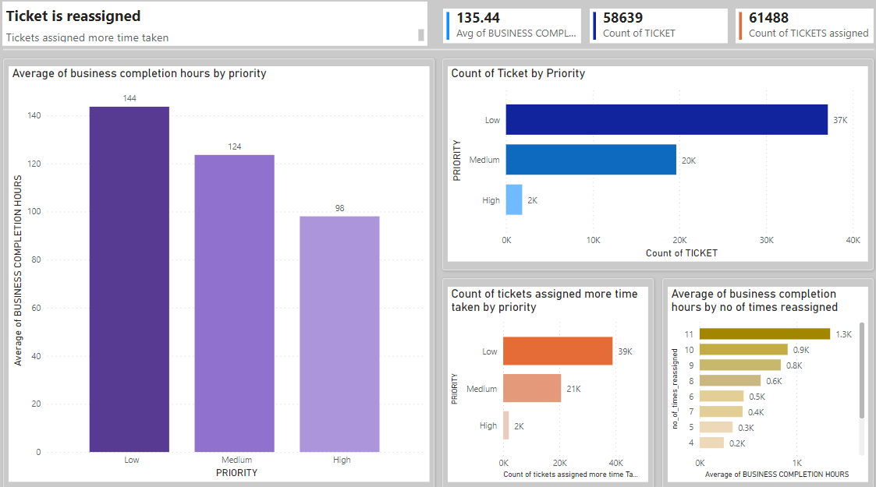

Slide 15
Summary of Insights
If 10% efficiency is increased on top 10 Assignment Group with high resolving time average, there is 7.11 % increase in efficiency of MTRS.
If 10% efficiency is increased on the top 10 services that take long time to resolve, there is 7% increase in efficiency of MTRS (Mean time to restore service)
If 10% efficiency is increased on top 10 organizations that take long time to resolve, there is 2.7% increase in efficiency of MTRS (Mean time to restore service)
A weak correlation of 0.305 in between the number of times an incident is reassigned and how long it took to restore.
In order to decrease the time that SSC take to respond to a newly opened ticket, the resources to handle the tickets should increase.

Slide 16


